Slide 1
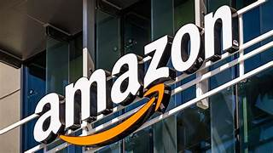
Project
Amazon Sale Report

Slide 2

History
Amazon, founded by Jeff Bezos in 1994, began as an online bookstore and has since evolved into a global technology giant, transforming how we shop, read, and consume media.
Its meteoric rise to become the world's largest online retailer and a major player in industries ranging from cloud computing to entertainment has been nothing short of astounding.
Join us as we track the fascinating history of Amazon, tracing its humble beginnings, strategic growth and acquisition moves, and impact on the world of e-commerce and beyond.

Slide 3
Objective
The objective of the project is to use skills to analyse a Amazon Company to perform exploratory data analysis by answering the question in the upcoming slides.

Slide 4
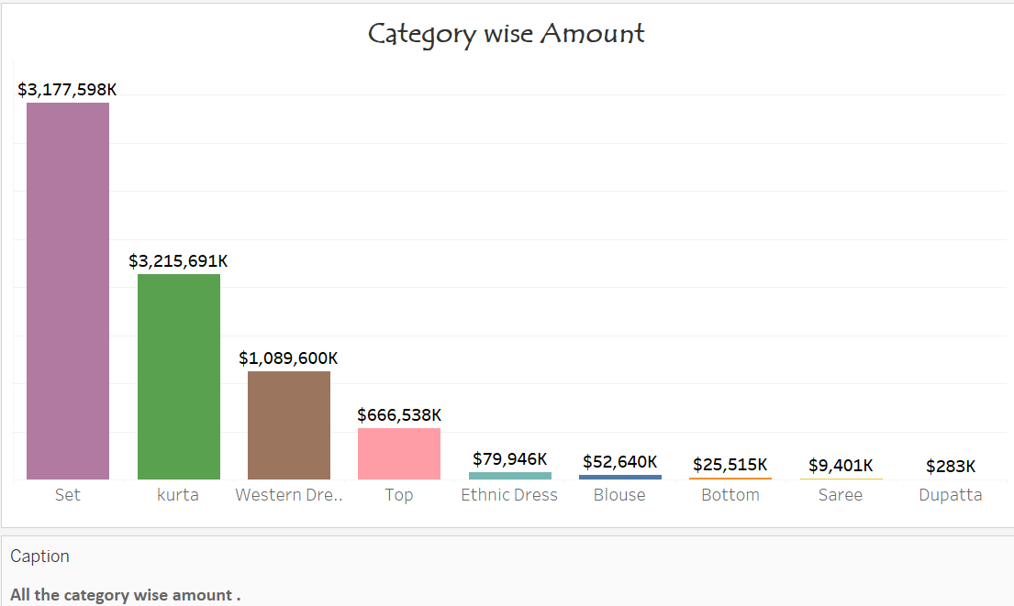
Task 1
Which category have the highest amount.

Slide 5
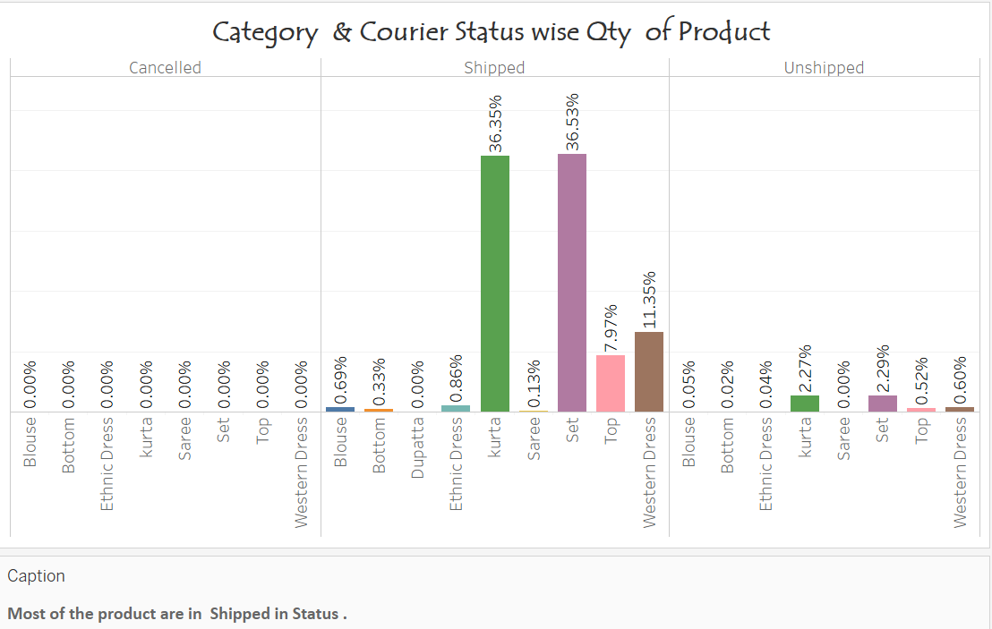
Task 2
Which category & courtier Status have the highest percentage.

Slide 6
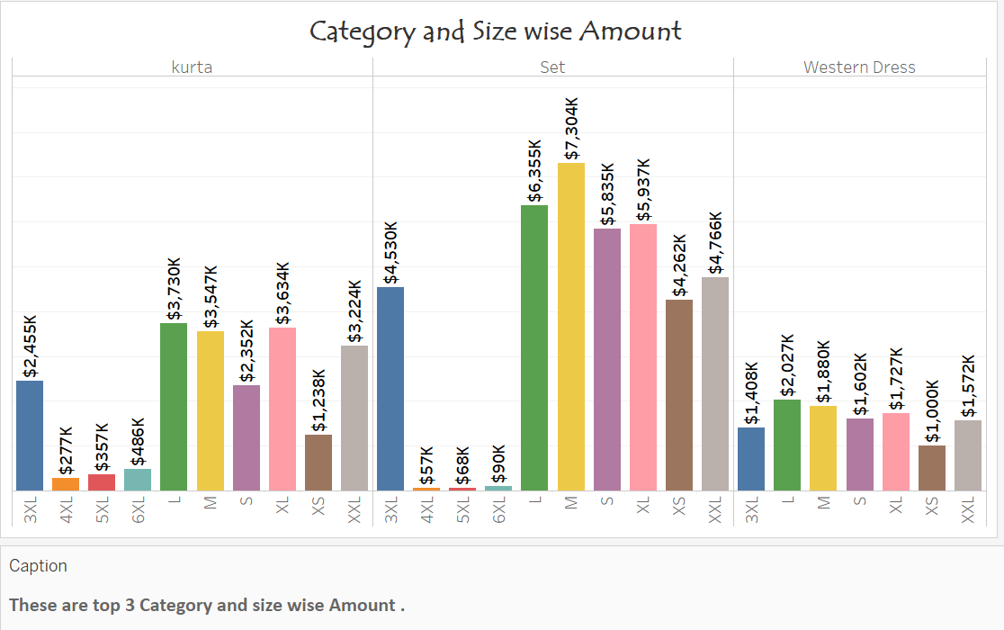
Task 3
Which category & size have the highest amount .

Slide 7
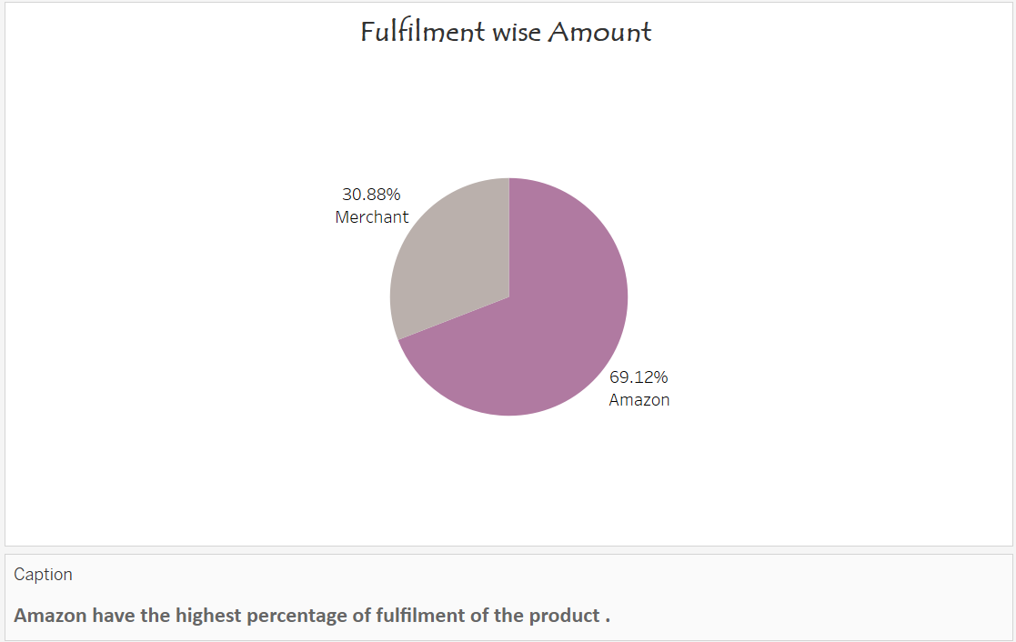
Task 4
What is the highest amount of percentage of fulfilment ?

Slide 8
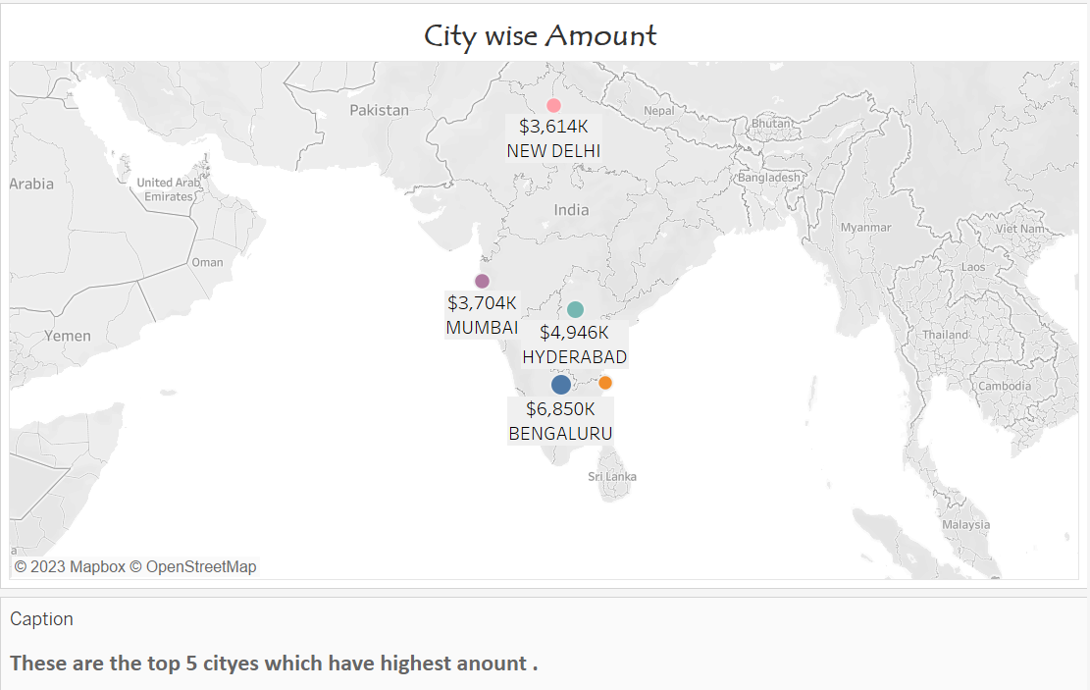
Task 5
What is the top 5 cities how have the highest amount ?

Slide 9
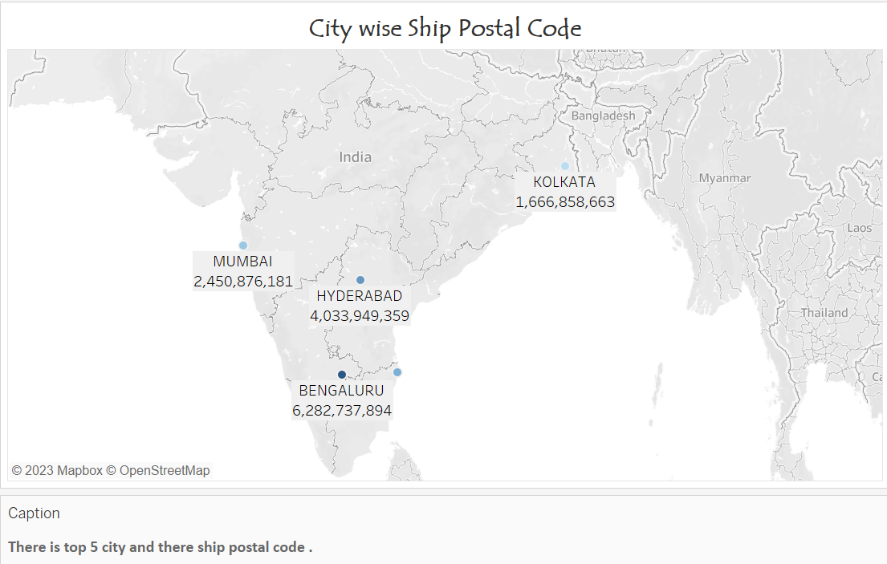
Task 6
What are the top 5 cities as per ship postal code ?

Slide 10
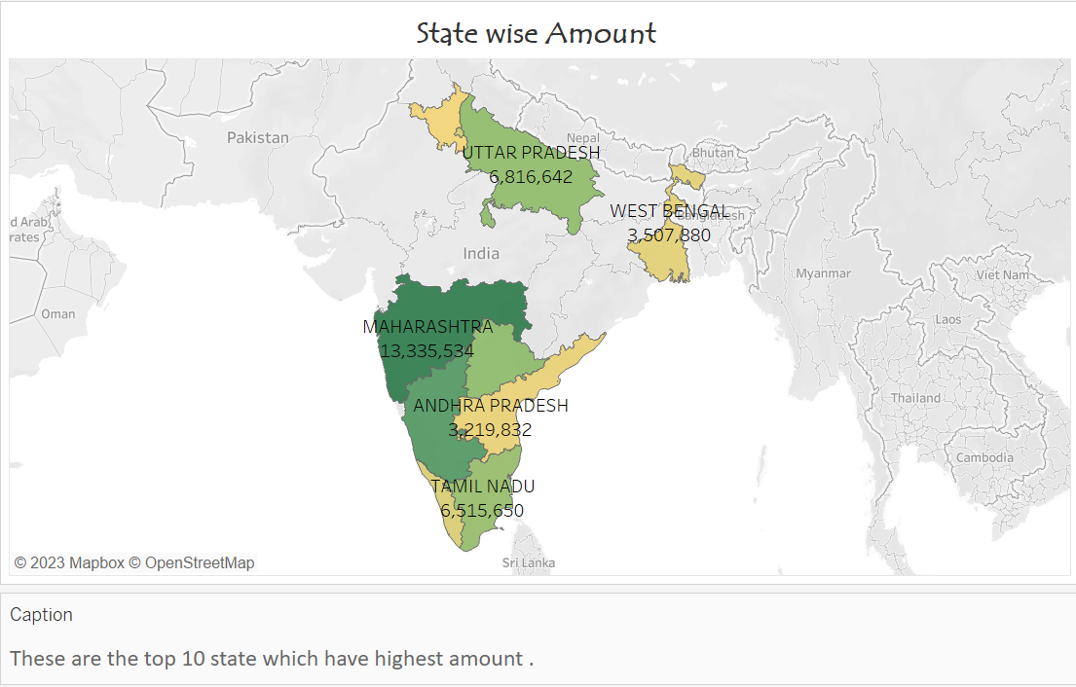
Task 7
What is the top 10 cities as per amount ?

Slide 11
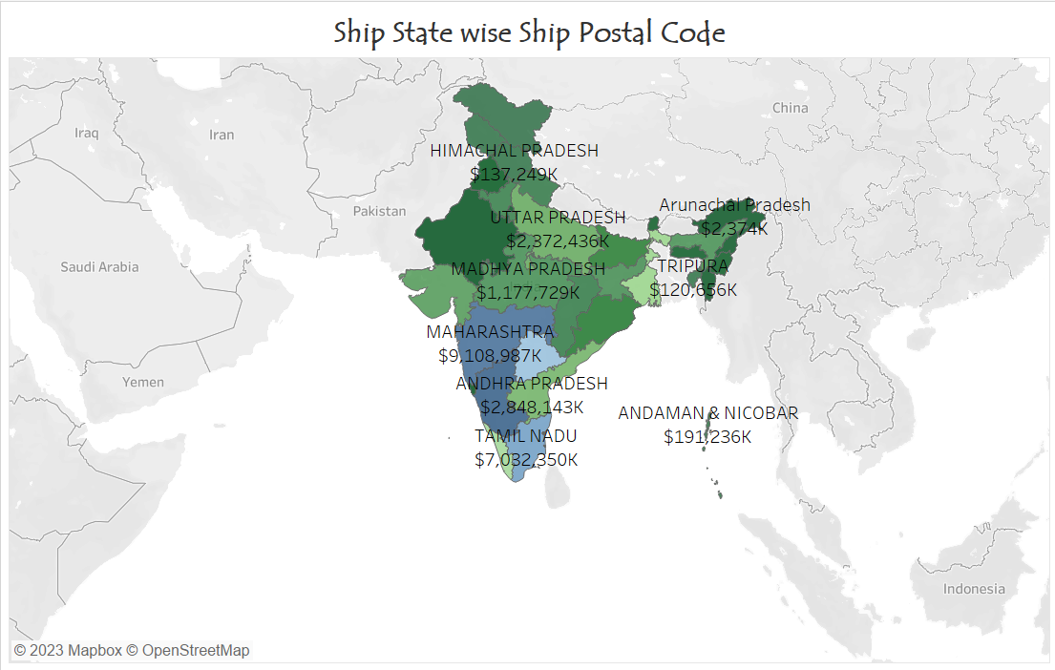
Task 8
What is the ship postal code of all states ?

Slide 12
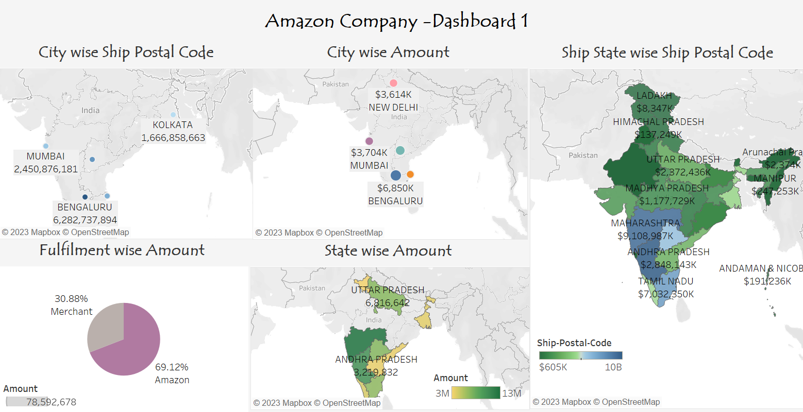

Slide 13
Conclusion
All the category wise amount .
Most of the product are in Shipped in Status .
These are top 3 Category and size wise Amount .
Amazon have the highest percentage of fulfilment of the product .
These are the top 5 cities which have highest amount .
There is top 5 city and there ship postal code .
These are the top 10 state which have highest amount .

Slide 14


